Slide 1
Fever and Rash
Notes:
Welcome to this Wessex Healthier Together case based workshop on common childhood respiratory presentations
This has been written by Paediatric Emergency Medicine clinicians and is geared towards the MDT working in Emergency Departments across Wessex
It will take between 30-45 minutes depending on the level of debate generated

Slide 2
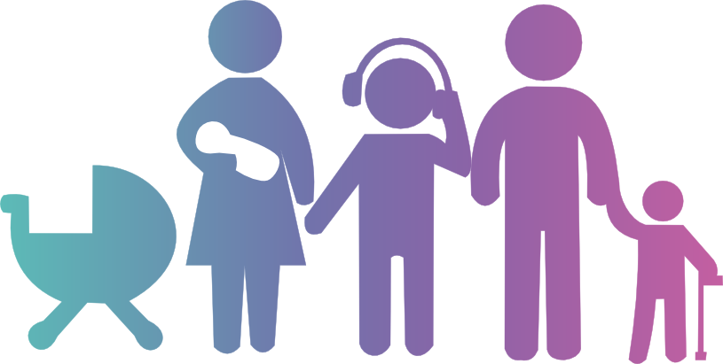
Case 1
5 year old boy
New onset rash on legs since 1 day
URTI 1 week ago
Complaining of pain in knees and ankles and tummy ache
O/E alert, interactive – “doesn’t look unwell”.
Warm peripheries, refill <2 seconds
Temp 38.1°, HR 110, RR 25
Purpuric rash on legs and swollen ankles

Slide 3
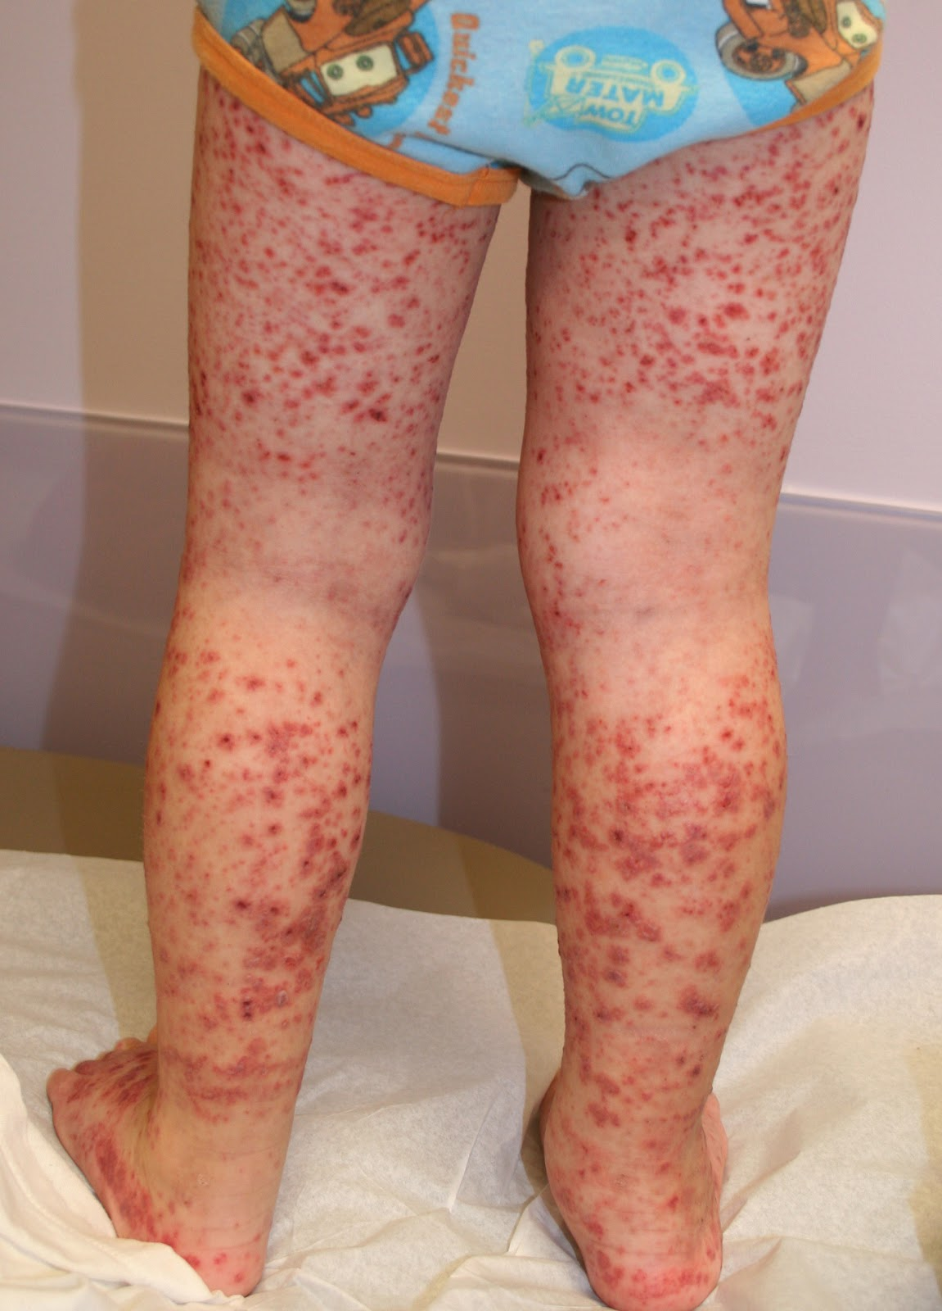
Case 1

Slide 4
Management
What would you do next?
Transfer urgently to hospital by ambulance?
Reassure and send home with safety net advice?
Review again later the same day?
Arrange urgent paediatric review?
Response Counter

Slide 5
Management
What do you think is going on?
Meningococcal Disease
Scarlet Fever
Measles
Other viral infection
Vasculitis
Malignancy
Response Counter

Slide 6
Henoch-Schonlein Purpura
Vasculitis – IgA deposition
Blood vessels, joints, GI tract, kidneys
Children > adults (2-11 years), boys > girls
Rash classically bilateral, extensor surfaces of legs, “palpable purpura” - Lasts 3-10 days on average
Systemically well (unlike meningococcal disease!)
Abdo pain in 50% - classically colicky; small risk of intussusception
Arthritis in >50%; ankles and knees
Renal involvement in approx. 25% - proteinuria or haematuria; monitor BP and urine – may progress to end stage renal failure
Recurs in <10%

Slide 7
Case 2
15 year old girl
Known Hx of HIV – on HAART
3/7 Hx conjunctivitis and sore throat
Fever since 2/7
Rash on torso since 2/7 – extending to limbs
Painful mouth since this am
Recent tonsillitis – treated with 7 days course of penicillin V; completed course 5 days ago
Temp 38.1°, HR 100, RR 24

Slide 8
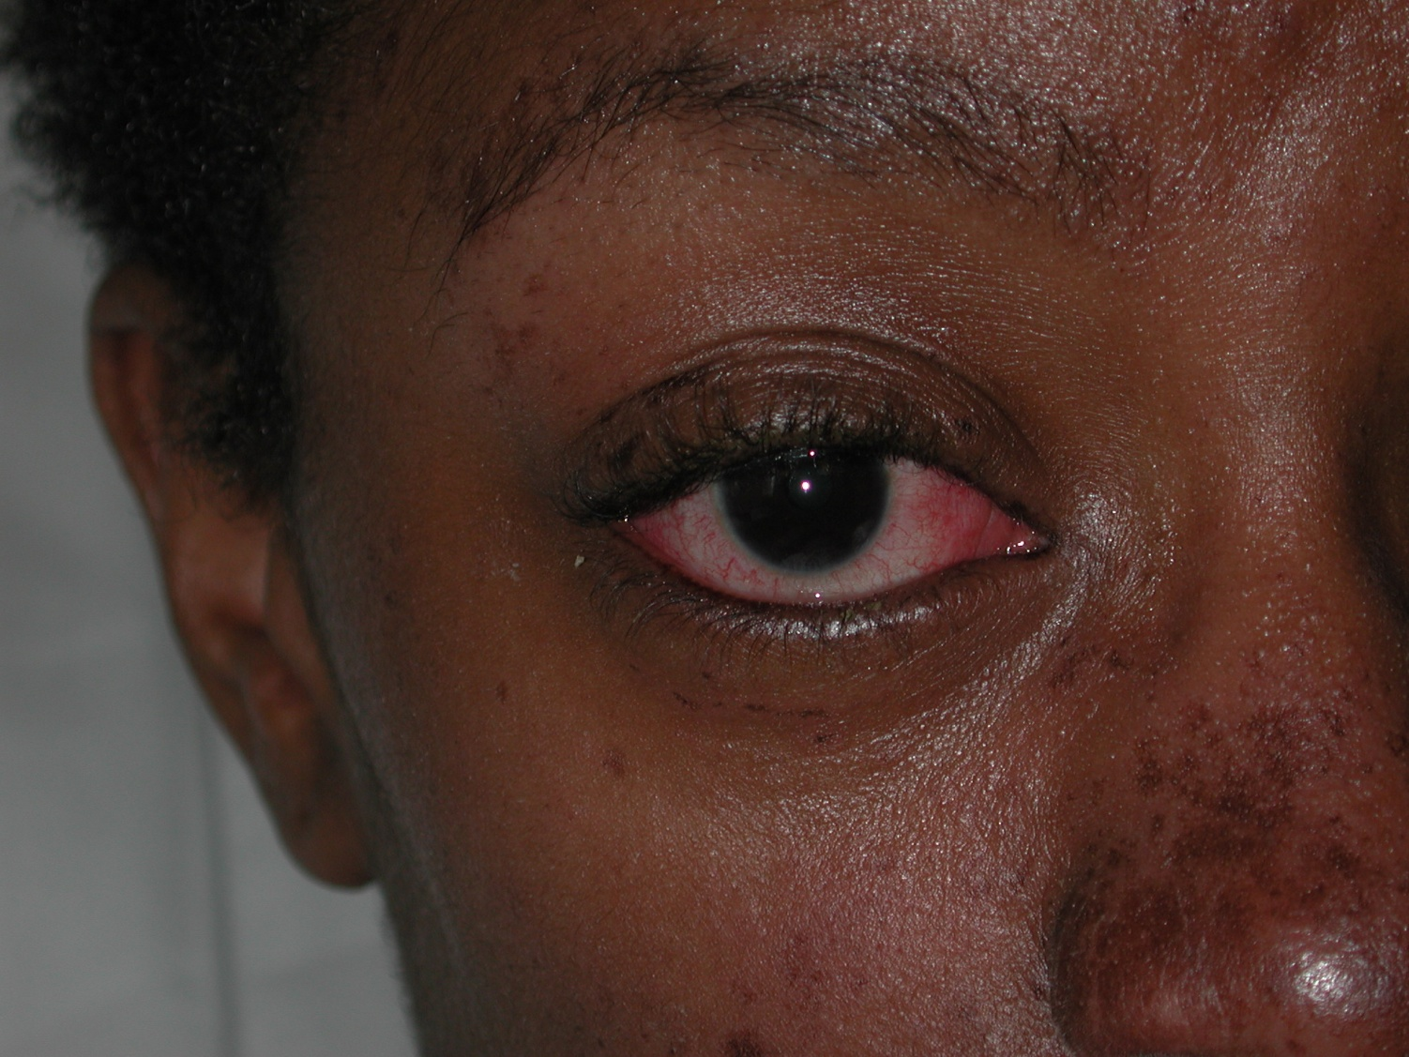
Case 2

Slide 9
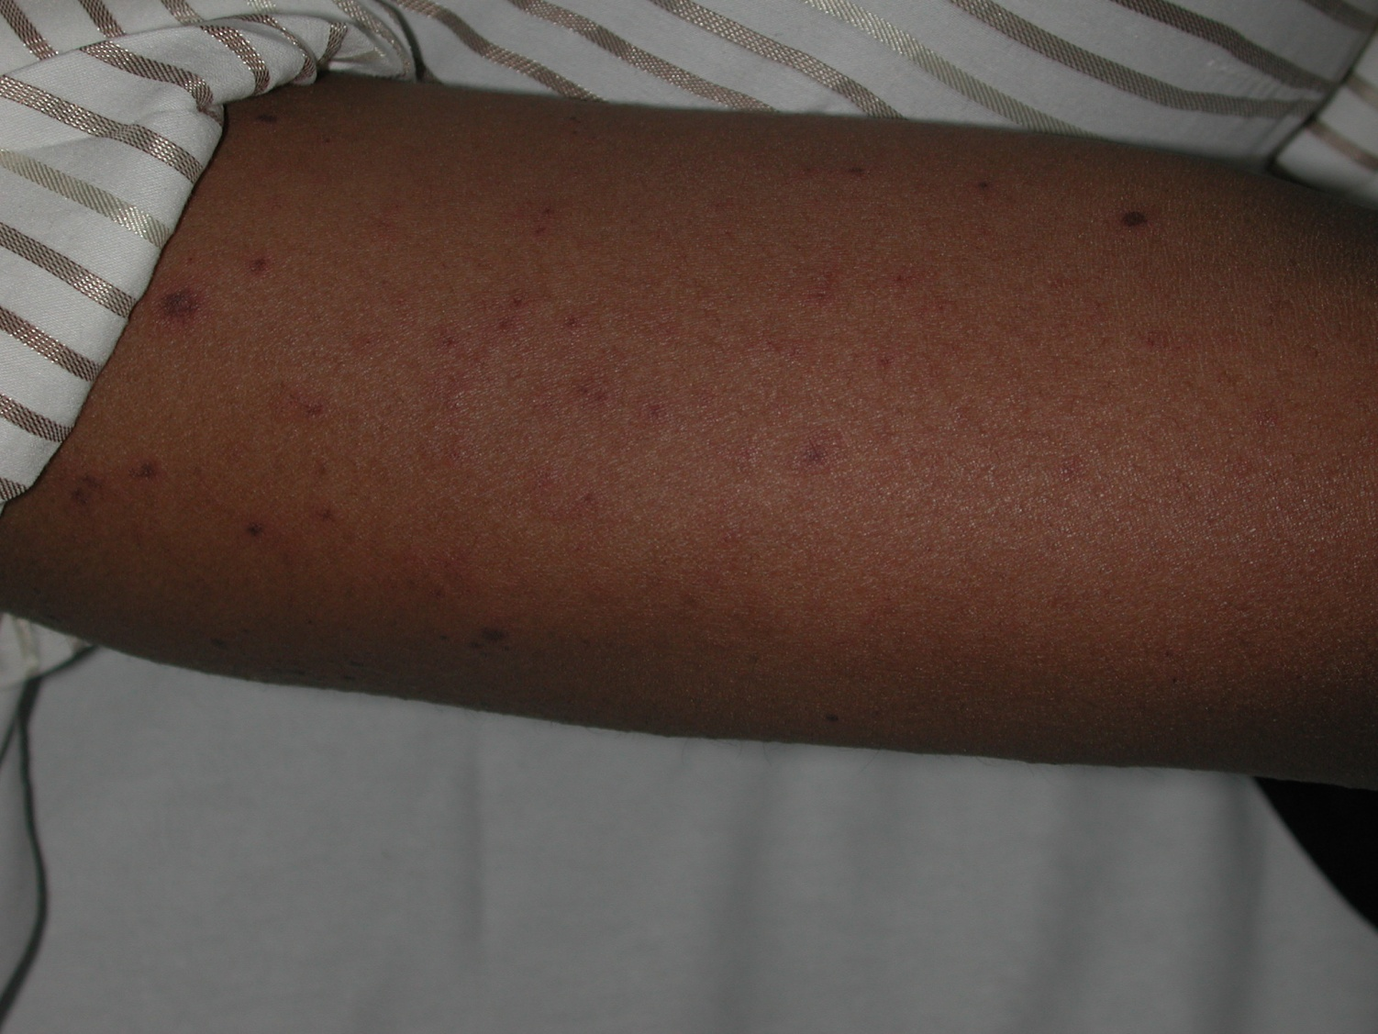
Case 2

Slide 10
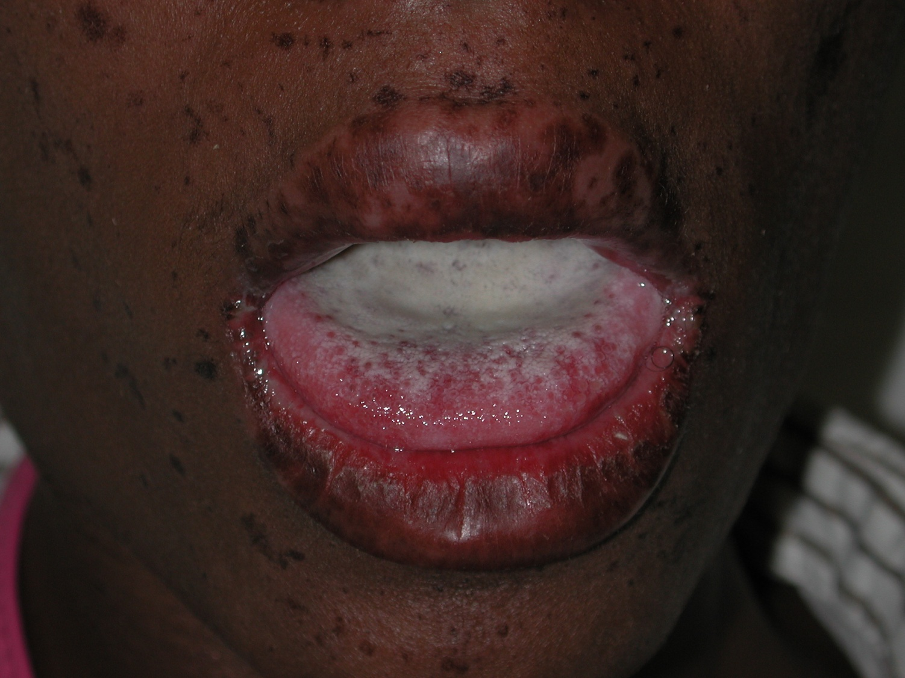
Case 2

Slide 11
Management
What do you think is going on?
Meningococcal Disease
Scarlet Fever
Steven-Johnson Syndrome
Toxic Shock Syndrome
Other viral infection
Vasculitis
Response Counter

Slide 12
Management
What would you do next?
Reassure and send home with fever safety net advice sheet and analgesia?
Review again later the same day?
Arrange urgent review in hospital?
Transfer urgently to hospital in ambulance?
Response Counter

Slide 13
Steven-Johnson Syndrome
Rash often preceded by prodromal illness (fever, sore throat, myalgia, conjunctivitis).
Rash starts on trunk, extends to limbs (spares soles and palms).
Mucosal involvement including eyes, mouth/lips, pharynx/oesophagus, genitalia, upper respiratory tract and GI tract.
Causes include infections and drugs
100 x increased risk in people with HIV
Supportive treatment re analgesia, fluids – if severe disease, steroids. If eye involvement, for ophthalmology review:
Ocular involvement in up to 50% of patients: ranges from mild mucopurulent conjunctivitis to severe perforating corneal ulcers

Slide 14
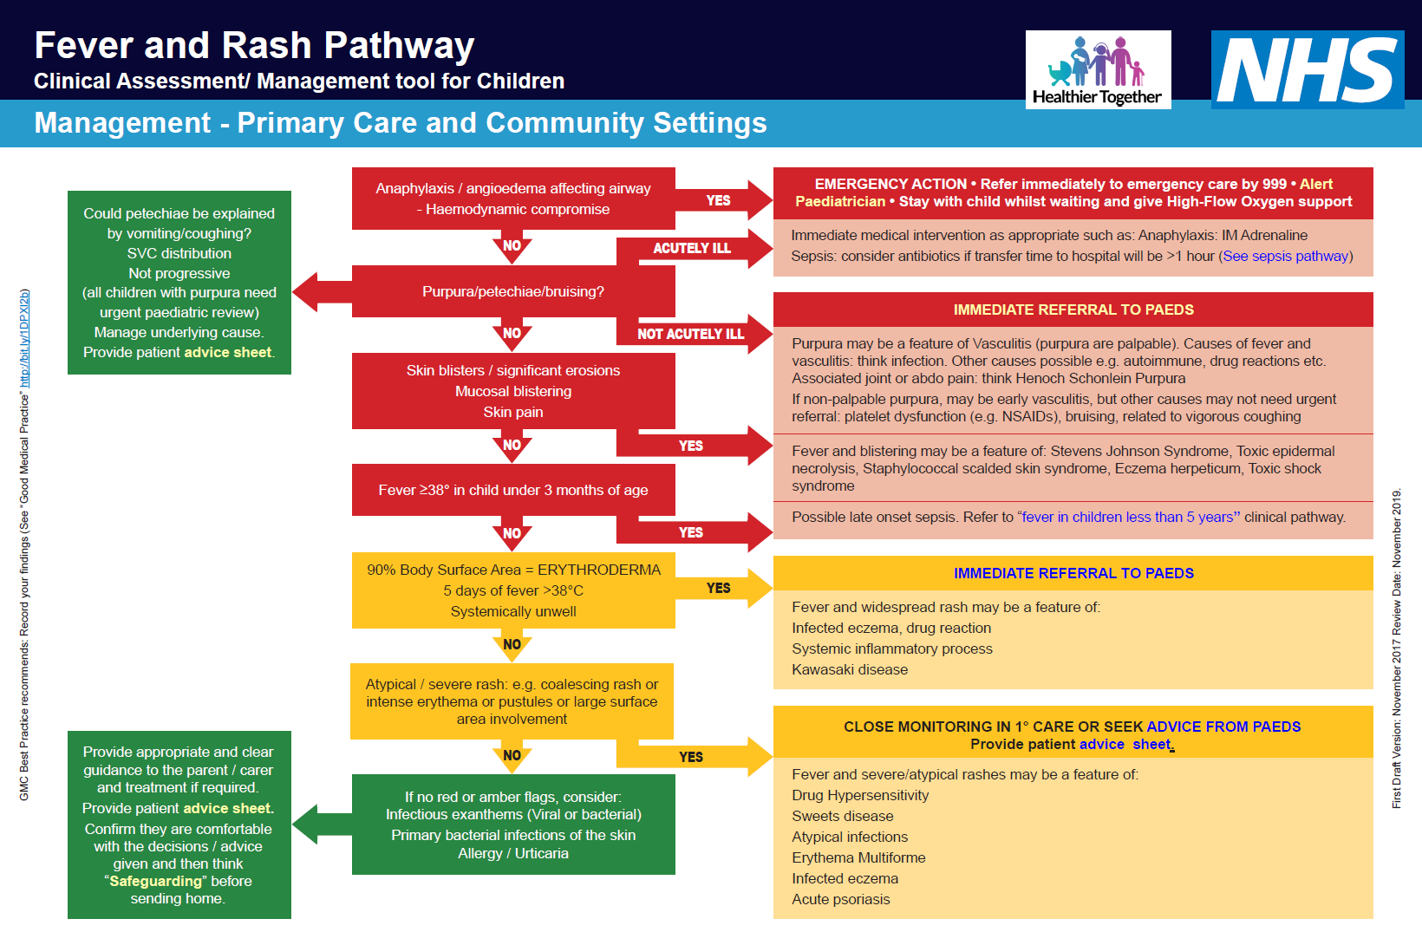
Case 3

Slide 15
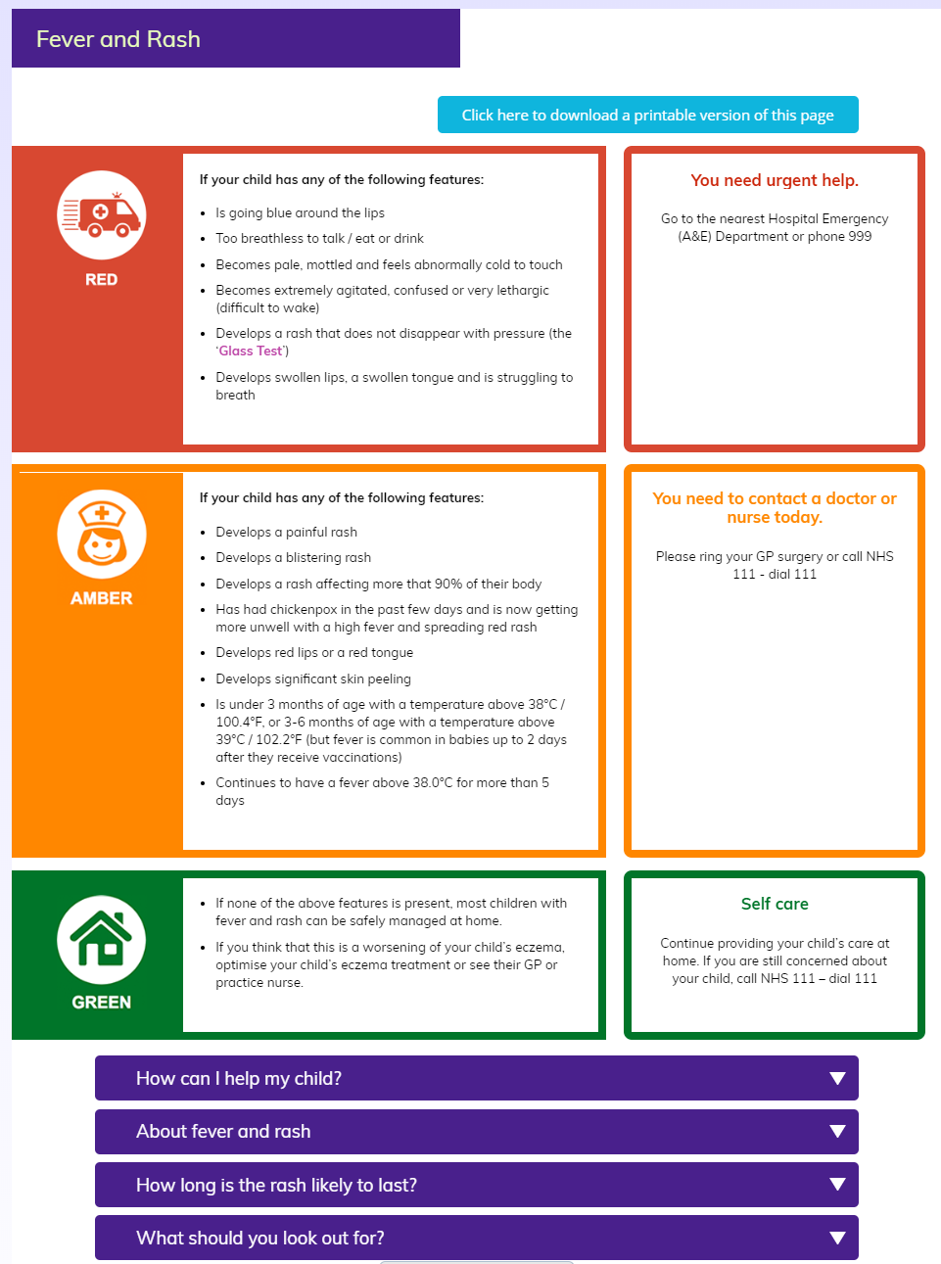
Safety netting

Slide 16
Case 3
2 year old boy with fever since 5 days:
Associated with overwhelming misery
Bilateral conjunctivitis day 2 – non-exudative – resolved by day 4
Generalised blanching rash day 3
Presented to primary care day 5

Slide 17
Case 3 - Presentation
Temp 39.5°, HR 160, RR 36, warm peripheries, refill <2 s
Widespread rash, papular, erythematous lesions; blanching
Miserable ++
Mucosal erythema – red lips and red tongue
No conjunctivitis
Cervical LAN – non-tender

Slide 18
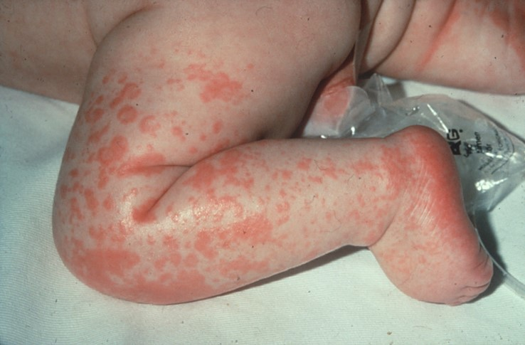
Case 3

Slide 19
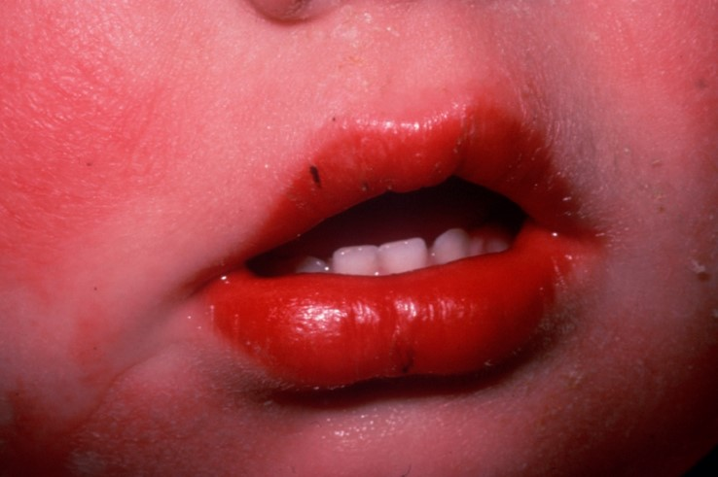
Case 3

Slide 20
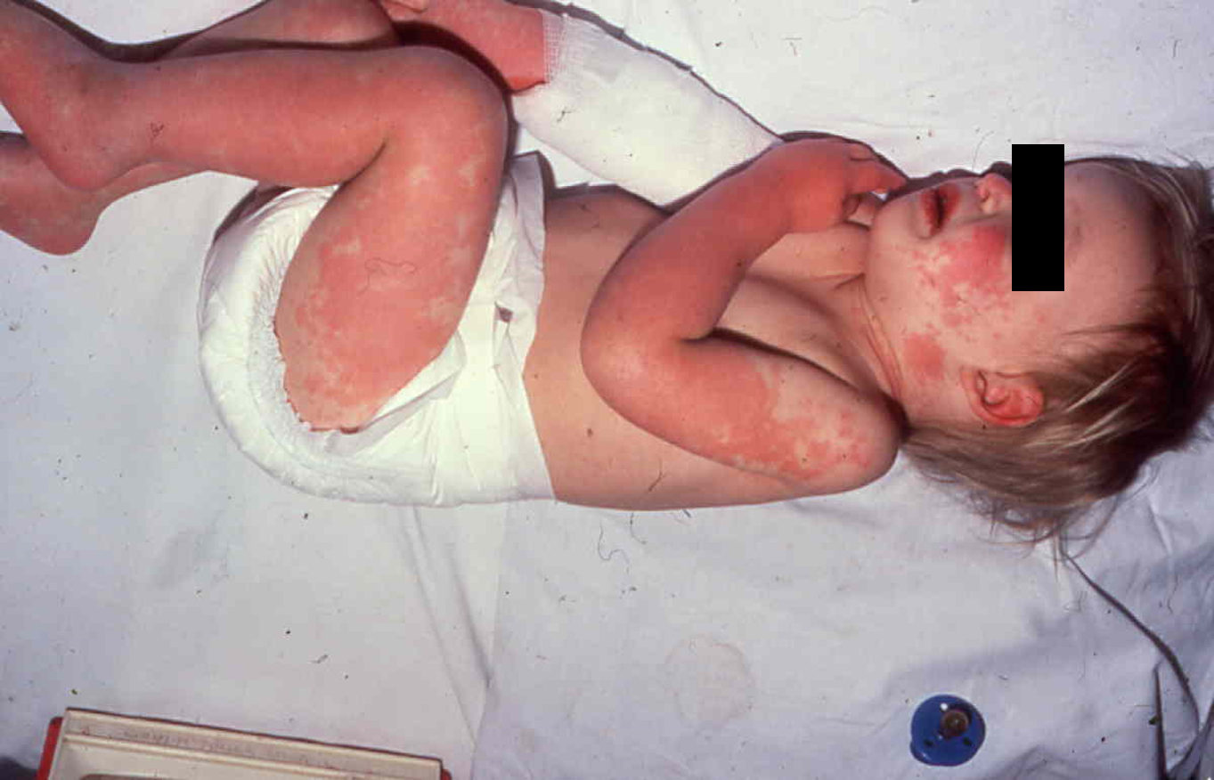
Case 3

Slide 21
Management
What do you think is going on?
Scarlet Fever
Meningococcal disease
Measles
Other viral infection
Vasculitis
Malignancy
Steven-Johnson Syndrome
Response Counter

Slide 22
Management
What do you do next?
Reassure and send home with safety net advice sheet?
Review again later the same day?
Call paediatrician urgently?
Transfer to hospital urgently by ambulance?
Response Counter

Slide 23
Case 3
Referred in to PAU
Bloods – CRP 156 mg/L, ALT 93 u/L, plts 319
Impression – Gp A strep
Started on IV ceftriaxone
B/C, viral throat swab, urine sent

Slide 24
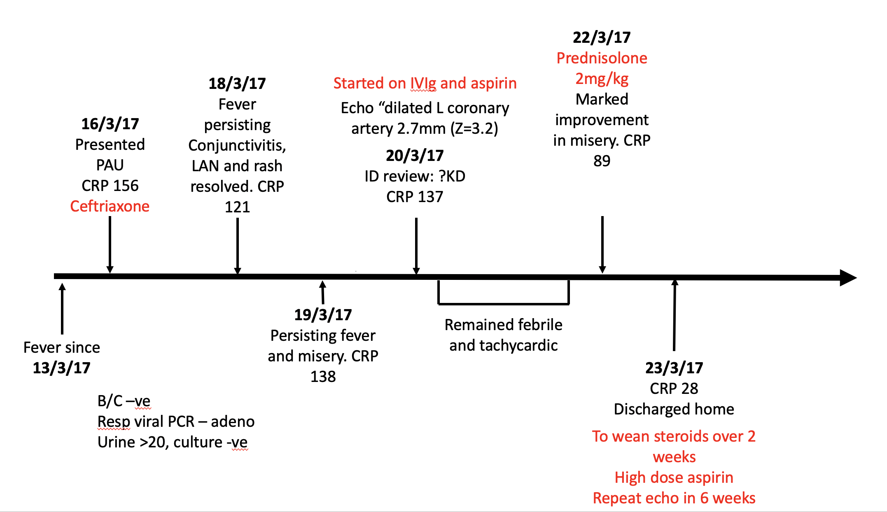
Case 3

Slide 25
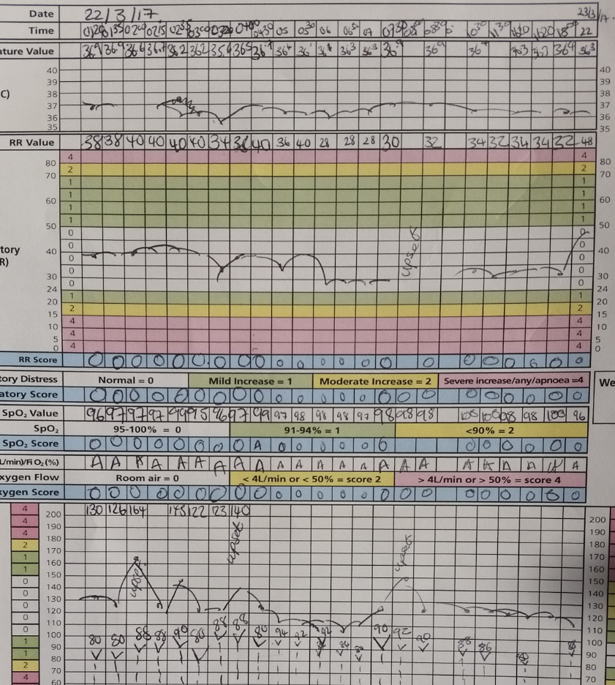
Case 3

Slide 26
Kawasaki Disease
Rare!
80% of cases occur in children <5 years of age (peak incidence 1 to 2 years).
Fever >5 days
Rash
bilateral non-exudative conjunctivitis
oral signs (red, cracked lips)
oedema of hands/feet
cervical LAN (>1.5cm).
Signs may appear and disappear before others arise.
PLUS: overwhelming misery extremely common. Reactivation of BG scar.

Slide 27
Key Points
CAUSES OF FEVER AND RASH:
Infection
Viral – enterovirus, HHV6, EBV, CMV, adenovirus, measles, mumps, rubella, parvovirus etc
Bacterial – impetigo, cellulitis, scarlet fever, staph/strep toxic shock syndrome, staph scalded skin syndrome
Vasculitis – Kawasaki disease
Connective tissue disease – JIA
Drugs – Stevens Johnson syndrome, allergy- immediate or delayed hypersensitivity
Trauma
Neoplasia

Slide 28
Key Points
Look out for red flags
Cardiovascular compromise
Mucous membrane involvement
Blistering/peeling of skin
Petechial/purpuric rash
Severe pain out of proportion to the clinical examination – think of necrotising fasciitis!

Slide 29
Any Questions?

